Slide 1
CLASSIFICATION OF
COMPUTERS

Slide 2

CLASSIFICATION OF COMPUTERS
1. According to Purpose
2. According to Types of Data Handled/ Technology
3. According to Size, Capacity and Speed

Slide 3
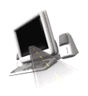
A. According to Purpose
General Purpose Computers
Designed to handle a variety of problems and to meet different needs
Used for varied applications
Virtually all computers from micro to mainframe are general purpose computers.
2. Special-purpose Computer

Slide 4
Special Purpose Computers
These are computers designed to handle a specific problem or to perform a specific task.
Examples of special-purpose computers are those used for collecting highway tolls, airline reservations, weather forecasting, satellite tracking, oil exploration, and industrial process control.

Slide 5

B. According to the Type of Data Handled
1. Analog Computers
The term analog is taken from the word “analogous” which means “similar”. Analog computers deal with continuously changing physical data (such as pressure, temperature, and current). Eg. automobile speedometer

Slide 6
2. Digital Computers
These are high speed programmable electronic device that specialized in counting.
Unlike the analog computer which receives data in continuous form, the digital computer handles values that are discrete (separate or distinct) in form. Since most business data are in discrete form, the digital computer is readily adaptable to business data applications, especially when repetitive arithmetic operations are involved and when 100 percent accuracy is demanded.
They represent data whether no. , letters or symbols in binary form.

Slide 7
3. Hybrid Computers
These computers are machines that incorporate in a single computer both analog and digital signals. These computers are used in working out special types of problems in science and various areas of engineering, such as space vehicle simulation and the training of astronauts.
They are usually used for special problems in which input data is derived from measurement is converted into digits and processed by data.

Slide 8
C. According to Size, Capacity and Speed
1. Supercomputers
These are the biggest, fastest and most expensive computers.
Applications range from nuclear weapons development to accurate weather forecasting and other applications where maximum speed and power are so important that costs are just secondary.
Used primarily for scientific applications that are mathematically extensive. The aerospace, automotive, chemical, electronics and petroleum industries use supercomputers extensively.
speed is measured in teraflops (trillions of operations per second). These types of computers derive much of their speed from the use of multiple processors.
Example: PARAM

Slide 9
2. Mainframes
Large, expensive, powerful computer that can handle hundreds of thousands of connected users simultaneously
Stores tremendous amount of data and information
Used by large companies such as banks, airlines, and insurance
Requires an environment with closely monitored humidity and temperature.
Cost considerably less than supercomputers
Used for extensive input-output operations
People access programs on a mainframe via terminals.
The term mainframe has fallen out of use in favor of enterprise server.
Eg: IBM Mainframe

Slide 10
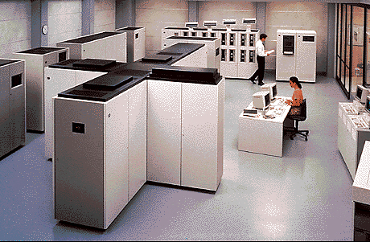
MAINFRAME COMPUTER SYSTEM

Slide 11
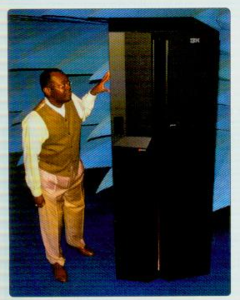
MAINFRAME

Slide 12
3. Midrange Server
Is more powerful and larger than a workstation computer
Typically supports several hundred and sometimes up to a thousand connected computers at the same time
Used to be known as minicomputers
They came into existence in 1960’s
They may be used in network servers and internet servers eg: IBM AS/400e, PDB- 11/70, Honeywell
4. Microcomputers
sometimes called “single-chip processor” or “system-on-a chip”, this computer is a digital computer system that uses a microprocessor, a read-only memory and a random-access memory.
They are commonly known as personal computers
They are the smallest, least expensive, consume less power and permit fewer peripherals to be attached.

Slide 13
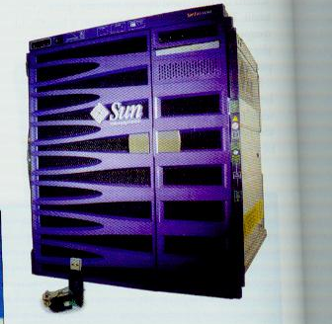
MIDRANGE SERVER

Slide 14
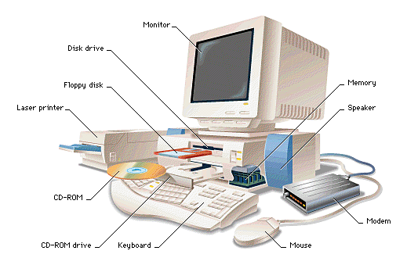
MICROCOMPUTER

Slide 15
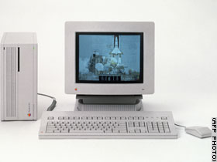
CATEGORIES OF MICROCOMPUTER
PC
The personal computer (PC) defines a computer designed for general use by a single person. While a Mac is a PC, most people relate the term with systems that run the Windows operating system. PCs were first known as microcomputers because they were a complete computer but built on a smaller scale than the huge systems in use by most businesses.

Slide 16
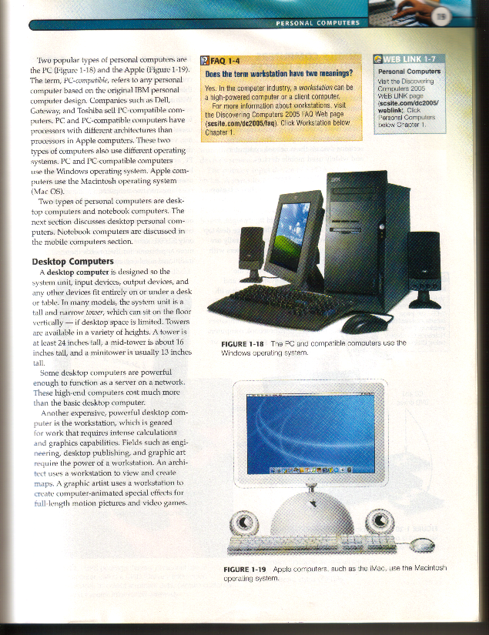
Desktop
A PC that is not designed for portability. The expectations with desktop systems are that you will set the computer up in a permanent location. Most desktops offer more power, storage and versatility for less cost than their portable brethren.

Slide 17
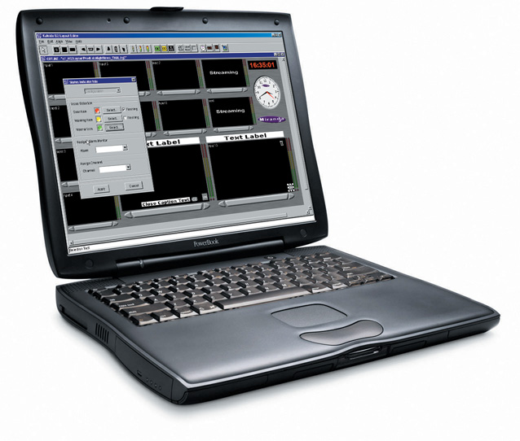
Laptop - Also called notebooks, laptops are portable computers that integrate the display, keyboard, a pointing device or trackball, processor, memory and hard drive all in a battery-operated package slightly larger than an average hardcover book.

Slide 18
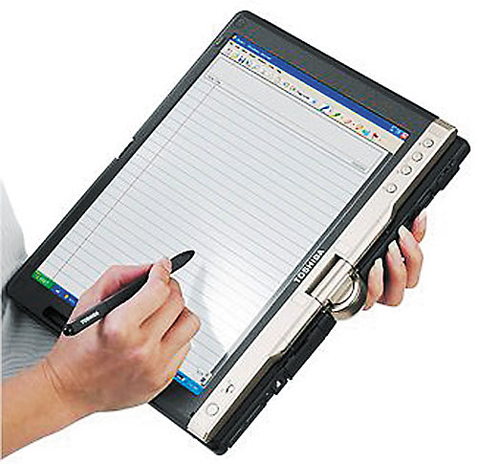
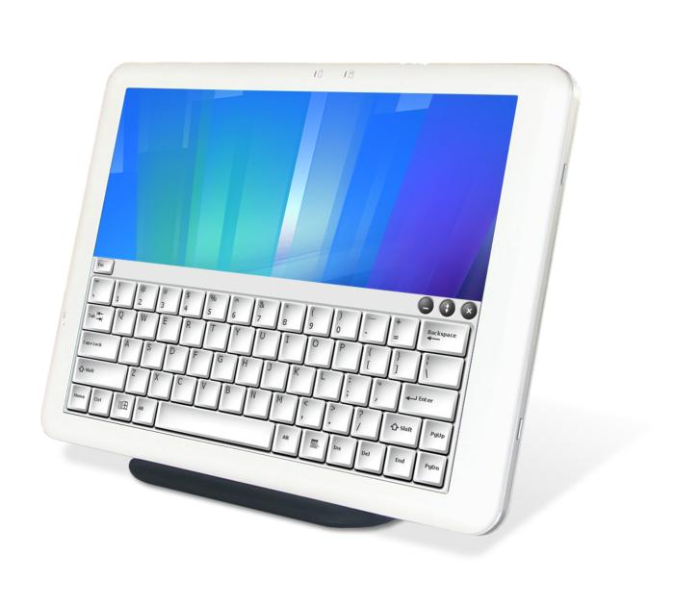
Tablet PC – is a special type of notebook computer that allows you to write or draw on the screen using a digital pen.

Slide 19
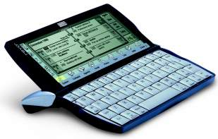
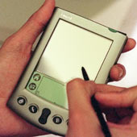
Palmtop - More commonly known as Personal Digital Assistants (PDAs), palmtops are tightly integrated computers that often use flash memory instead of a hard drive for storage. These computers usually do not have keyboards but rely on touchscreen technology for user input. Palmtops are typically smaller than a paperback novel, very lightweight with a reasonable battery life. A slightly larger and heavier version of the palmtop is the handheld computer.

Slide 20
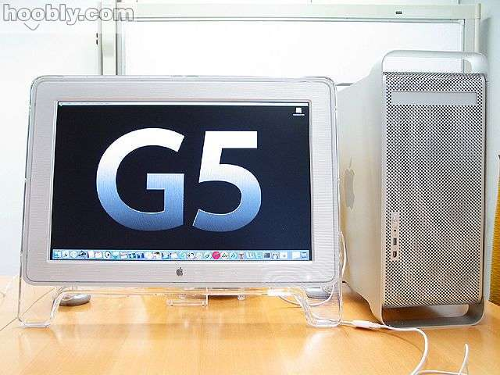
Workstation
A desktop computer that has a more powerful processor, additional memory and enhanced capabilities for performing a special group of task, such as 3D Graphics or game development
APPLE’S POWERMAC G5

Slide 21
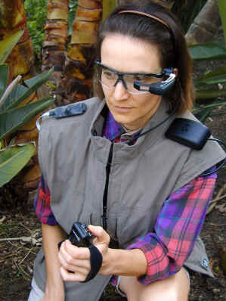

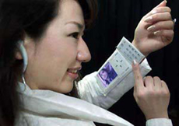
Wearable - The latest trend in computing is wearable computers. Essentially, common computer applications (e-mail, database, multimedia, and calendar/scheduler) are integrated into watches, cell phones etc.

Slide 22
Comparisons between different types of computers:
Type
Components
Physical Size and Capacity
Cost
Usage
Microcomputer
All components in a single unit
Smallest
Cheapest
At homes, in schools and offices
Minicomputer
Several functional units
Small
Cheap
In universities, medium-sized companies, departments of large companies
Mainframe computer
Several separate units
Large
Expensive
In large organizations, universities, government
Supercomputer
Several separate units
Largest
Most expensive
In scientific research, weather forecasting, space exploration, military defense

